Slide 1
Security Awareness
ITS Security Training
Fall 2017

Slide 2
You are the target…
You, and your access to University data, are now the primary target of hackers.
Gaining access to your login information allows them to impersonate you, or use your computer, to gain access to UofM systems and data.
Technology can address only a fraction of security risks.

Slide 3
Security Awareness Basics
University Policies
Password Security
Email Security
Safe Browsing
Ransomware
Privacy
Data Security and Encryption
Mobile Device Security
Duo Account Security
Securing The Human Training
Reporting an incident
Reminders
Other Security Resources
Notes:
Talking points:
Browsing - http/https, exploits, software/plugin versions
Theft and data loss - laptop, USB flash device, data corruption
Inappropriate data access - P2P file sharing - legal implications
Discarded media and hardware - wipe or destroy media, laptops

Slide 4
UofM IT Security Policies and Guidelines
Policies:
UM1337 – Data Access
UM1535 – Acceptable Use of IT Resources
UM1566 – Security and Protection of IT Resources
UM1691 – Campus Data Security
UM1804 – Information Security Program
UM1805 – Email Use
Guidelines and Best Practices:
http://www.memphis.edu/its/security/policies-guidelines.php
http://www.memphis.edu/its/security/best-practices.php

Slide 5
Password Security
Password Reuse
Maintain different credentials per service. Hackers know it’s hard to keep up with multiple passwords. If they get one, they will use it against other services hoping to gain additional access. Never use your University of Memphis credentials with another service.
Password Complexity
Avoid over-simplified or very short passwords.
Use longer passwords composed of standard words that you can remember or the first letter in a sentence or phrase. The longer the password, the more difficult to crack.
The University of Memphis enforces a standard set of complexity requirements to help create strong passwords.
Password Change Frequency
Frequency can be as important as complexity. Expired passwords are useless.
The University of Memphis currently enforces a 6 month expiration policy.

Slide 6
Password Management
ITS will never ask you for your password.
Avoid writing passwords down or keeping them in an insecure text file or document.
Email is not a password management system. Never email your password to anyone (including yourself).
A password management utility is one option for storing personal passwords. Many exist that work on desktops and mobile devices. These encrypt your passwords and many will also help you generate complex passwords.
1Password and LastPass are examples of password management utilities.

Slide 7
Email Security
Email is one of the most common and most successful attacks on the internet. Recent statistics cite up to 90% of successful attacks against businesses begin with a malicious email.
Emails can contain malicious files like virus and malware, link to malicious web sites, or try to coerce or convince you to give away personal information, like your username and password.
Cybercriminals using email to attack businesses are becoming more and more effective at evading detection – technology alone is only marginally effective at blocking these new email threats.

Slide 8
Email Do’s and Don’ts
Do:
Always verify the sender of a message.
Always hover over web page links (URLs) in email messages to see where they link to – beware URL shortening services (like bit.ly) that may obscure the final web site destination.
Be skeptical of messages with odd spelling/grammar, improper logos or that ask you to upgrade or verify your account.
Report suspicious emails to abuse@memphis.edu.
Don’t:
Open an attachment from an unknown sender. Consider the source and whether or not the file was expected.
Click on a link from an unknown sender.
Email someone your username or password.

Slide 9
Email Threat Examples
Phishing
Viruses and Malware
Email Spoofing
Other Scams

Slide 10
Phishing
Phishing is the attempt to obtain sensitive information such as usernames, passwords, and credit card details (and, indirectly, money), often for malicious reasons, by disguising as a trustworthy entity in an electronic communication. (Wikipedia - https://en.wikipedia.org/wiki/Phishing )
Common phishing scams attempt to use coercion or scare tactics to get you to enter your username and password into a phony web site, such as:
A “required action” as a part of a system or quota upgrade
A “required action” to prevent email account closure
A “trusted” vendor, such as a fake Dropbox or Google alert
A “legitimate” banking alert
Once they have your password, phishers use your account credentials to send more phishing messages, change financial account information or redirect checks/deposits.

Slide 11
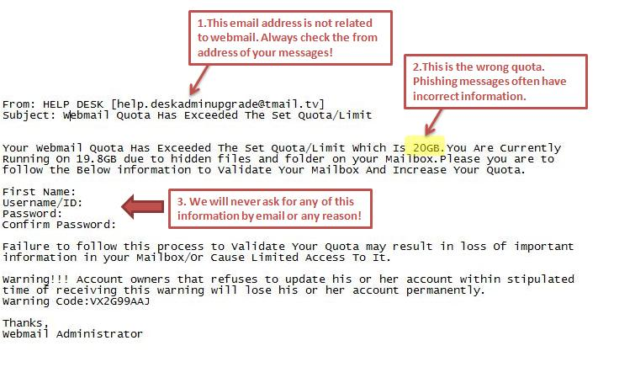
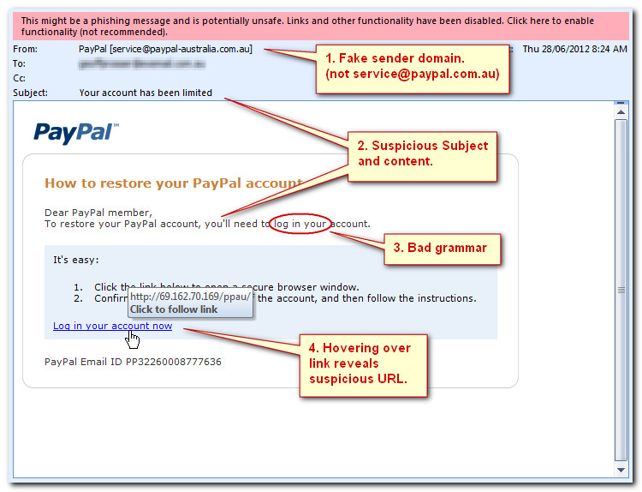
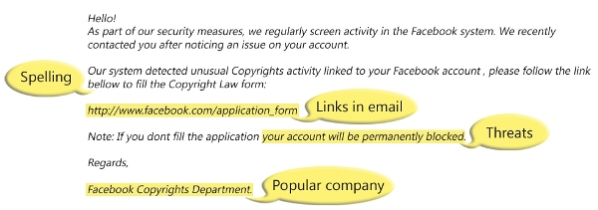
Phishing Examples

Slide 12
Viruses and Malware
Cybercriminals also use attachments to spread viruses or other malicious software (malware) to steal or destroy data.
Malware can install keyloggers to capture everything you type, control your webcam/microphone, or send all of your data to remote servers that the criminal controls.
The attachment typically arrives as Word, Excel or PDF file and has to be opened before the malware triggers.
Malware will take advantage of unpatched software.
Some Word/Excel malware require you to enable Macros – always be suspicious of an attachment that requests you to “lower” your security settings when opening.

Slide 13
Email Spoofing
Also called Business Email Compromise, email spoofing typically uses an email address that mimics a trusted party, such as a manager, executive or co-worker, and can be difficult to recognize (especially on mobile devices).
Typically these scams involve a wire transfer or request for sensitive files, such as W-2s or legal documents.
There is usually some urgency involved to prevent the recipient from following up on the request directly or following procedures.

Slide 14
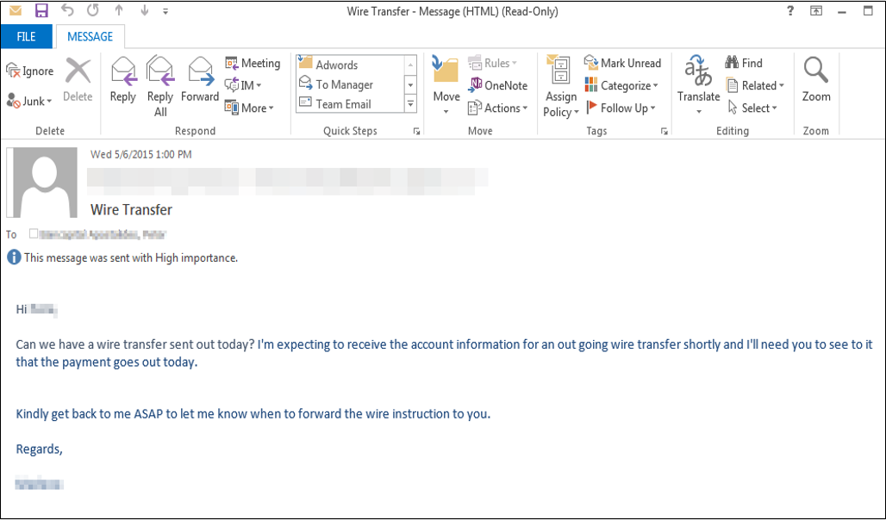
Email Spoofing Example
Notes:
https://info.phishlabs.com/blog/fbi-fraud-alert-business-e-mail-compromise

Slide 15
Advance-Fee Scams
Most other email scams involve advance-fees and check fraud, attempting to gain your confidence to move money on the criminal’s behalf.
Nigerian “419” scams are the classic example – your help is needed to move a large amount of money out of a foreign country because someone is ill, has died, or the country’s government is after it. The victim wires money to assist and never receives anything in return.
New variations include job offers – a sizable wage is sent in advance for a low amount of work, deposited, then requested to be transferred to another source for payment of some debt. Original check bounces and the victim has just wired their own money to the criminal.

Slide 16
Safe Web Browsing
Keep your browser software version up-to-date.
Keep any browser plug-ins up-to-date; especially Adobe Flash and Java, as these are targeted frequently.
Hover over URLs and links.
Make use of pop-up and ad blockers.
Be aware of where Google or other web searches are sending you.
Be careful when downloading software from the internet.
If a website requests user information of any kind, make sure that website is using HTTPS. Look for the padlock or other indicators that the page is secure, such as a site that begins with https://
Notes:
Discuss “hovering” in more depth – potentially show example.
What is encryption? - Method of encoding and securing the content so that others cannot read it.

Slide 17
Ransomware
Ransomware is a new type of malware that encrypts documents, pictures and other files, making them unreadable. The attacker then holds the decryption key for ransom until you agree to pay money, usually through an untraceable method such as BitCoin or other digital currency.
Ransomware assumes that you’ll pay to recover your files – if you back them up regularly, you have no need to pay the ransom.
On UofM machines, store files on your network (H:) drives, UMdrive, etc. At home, use external drives or trusted cloud services.

Slide 18
Privacy
Social media and networking sites, by definition, collect, maintain, and share personal identification.
Be mindful of what information you share about yourself and your family online or with others in electronic communications.
Social networking sites can be used by attackers to collect information about you to use against you. Social engineering attempts to use information the attacker knows about you and your relationships with others to your build trust.
Always check your sharing settings to limit the information you share with public or untrusted users.

Slide 19
Data Security and Encryption
Per policy UM1691, UofM employees are responsible for ensuring the security of the data that they access.
Restricted or other sensitive data, as defined by the Classification of University Data document, should never be stored on insecure or unsupported storage platforms.
Dropbox, Box, Google Drive, and other cloud platforms are not appropriate for the storage of Restricted University data.
See https://www.memphis.edu/its/security/data-storage-guidelines.php for further guidelines on storing University electronic data.
Restricted and/or sensitive data should be encrypted whenever possible. Supported encryption technologies are described at http://www.memphis.edu/its/security/policies-guidelines.php. Your LSP can assist with encrypting data.
Keeping sensitive data on campus servers alleviates the risk of a stolen mobile device or compromised home computer.
When disposing of old devices (desktops, laptops, flash drives, phones), ensure all sensitive data has been securely deleted. LSPs will assist with this process on UofM-owned equipment.

Slide 20
Mobile Device Security
Keep your device software up to date – unpatched software leaves your device vulnerable to attack. Install operating system updates as well as updates to applications.
Have anti-virus and/or anti-malware software installed, enabled and set to automatically update.
Never leave your laptop or mobile device unattended. Thefts do happen.
Encrypt laptops and external media that contains restricted or sensitive data.
Make sure you backup your data frequently in case your device is ever lost or stolen.
Ensure access to your mobile device is protected with a passcode and use built-in encryption settings to ensure that your data is safe if your device is ever lost or stolen.
Consider using a remote tracking/wipe function if supported. For iOS devices, iCloud provides the “Find my iPhone” service for free. Android and other mobile operating systems also have similar functionality.

Slide 21

Duo Account Security
Duo Account Security is a multi-factor authentication (MFA) solution that allows you to use a second factor that you have or have access to when you log in to your account.
That second factor could be an app on a mobile device or receiving a phone call or text message, or even a one-time passcode.
Whichever factor is used, the important thing is that should someone obtain your username and password, they will not have access to your phone or other device and would not be able to complete the login process.

Slide 22
SANS Securing The Human
Security Awareness Training is mandatory for all Banner Finance / HR users.
Training must be taken once a year and consists of a group of short videos followed by short quizzes.
Certificate of completion can be printed at end of assessments.
https://sso.securingthehuman.org/uofmemphis

Slide 23
Reporting Incidents
Phishing / Spam email messages can be reported to abuse@memphis.edu.
Real security incidents, such as compromised credentials, compromised system or evidence of data exposure/release, can be reported using our online form at https://www.memphis.edu/its/security/incident-report.php.

Slide 24
Reminders…
ITS will never ask…
… for your password via email or over the phone.
… for you to “confirm”, “upgrade” or “reactivate” your account via email.
… for you to follow a link to clean a virus from your email mailbox.
… for you to update or increase your email quota.
When in doubt, forward suspicious emails to abuse@memphis.edu.

Slide 25
Other Security Resources
ITS Security website
https://www.memphis.edu/its/security
CIO blog
https://blogs.memphis.edu/cio
Stay Safe Online – National Cyber Security Alliance
https://www.staysafeonline.org
US-CERT
https://www.us-cert.gov
FTC Privacy, Identity & Online Security
https://www.consumer.ftc.gov/topics/privacy-identity-online-security
SANS Cyber Security Awareness
https://cyberaware.securingthehuman.org

Slide 26

Open Discussion

Slide 27
THANK YOU!
ITS Security
http://www.memphis.edu/its/security/

